Slide 1

Customer Shopping Behavior Analysis
Uncovering insights from 3,900 purchases to guide strategic business decisions through data-driven analysis of spending patterns, customer segments, and product preferences.

Slide 2

Dataset Overview
3,900
18
50
Total Purchases
Data Features
Locations
Transactions analyzed across all categories
Columns tracking customer and purchase details
Geographic distribution of customers
$59.76
Average Purchase
Mean transaction value across all orders

Slide 3

Data Preparation & Engineering
Python Analysis
Comprehensive data cleaning and preparation using pandas:
Loaded and explored dataset structure
Imputed 37 missing Review Rating values using category medians
Standardized columns to snake_case format
Created age_group and purchase_frequency_days features
Removed redundant promo_code_used column

Slide 4

Revenue Insights by Demographics
Gender Revenue Split
Male customers generated $157,890 in revenue compared to $75,191 from female customers—more than double the contribution.
Age Group Performance
Young Adults led with $62,143, followed by Middle-aged ($59,197), Adults ($55,978), and Seniors ($55,763).

Slide 5
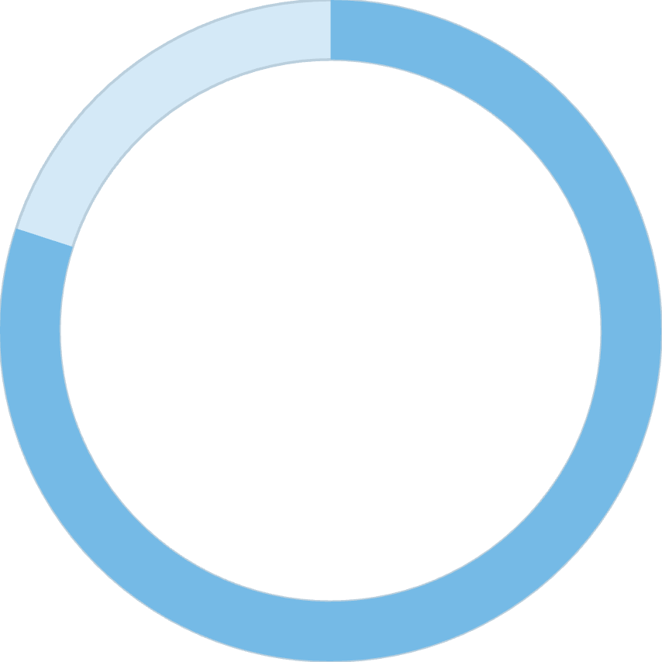
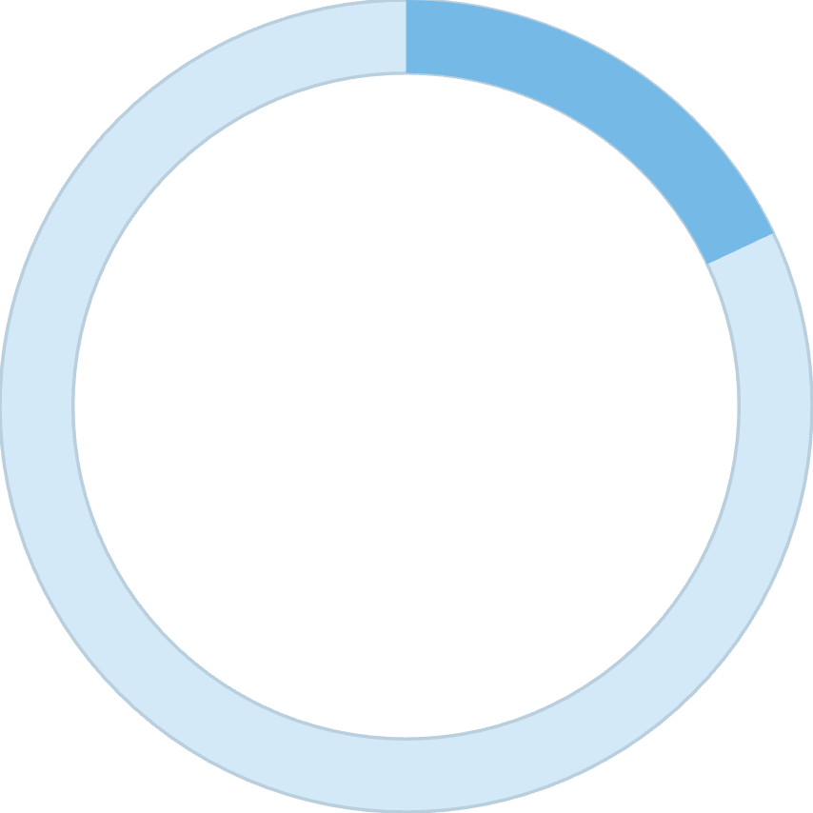

Customer Segmentation Analysis
80%
18%
2%
Loyal Customers
Returning Buyers
New Customers
3,116 customers classified as loyal based on purchase history
701 customers making repeat purchases
83 first-time purchasers in the dataset
The overwhelming majority of customers are loyal, presenting opportunities to convert returning buyers into the loyal segment through targeted engagement.

Slide 6

Subscription Status Comparison
Subscribers (27%)
1,053 customers
Average spend: $59.49
Total revenue: $62,645
Non-Subscribers (73%)
2,847 customers
Average spend: $59.87
Total revenue: $170,436
Despite similar spending patterns, only 27% have subscriptions. Among repeat buyers (5+ purchases), 958 are subscribers while 2,518 are not—a significant conversion opportunity.

Slide 7
Product Performance & Ratings
Top Rated: Gloves
Sandals
Boots
Average rating: 3.86
Average rating: 3.84
Average rating: 3.82
Overall average review rating across all products: 3.75 stars

Slide 8



Discount Strategy Analysis
High-Value Discount Users
Discount-Dependent Products
Shipping Impact
839 customers used discounts but still spent above the $59.76 average, indicating price sensitivity doesn't always mean lower value.
Hat (50%), Sneakers (49.66%), Coat (49.07%), Sweater (48.17%), and Pants (47.37%) show highest discount rates.
Express shipping customers averaged $60.48 vs. $58.46 for Standard—premium service correlates with higher spending.

Slide 9
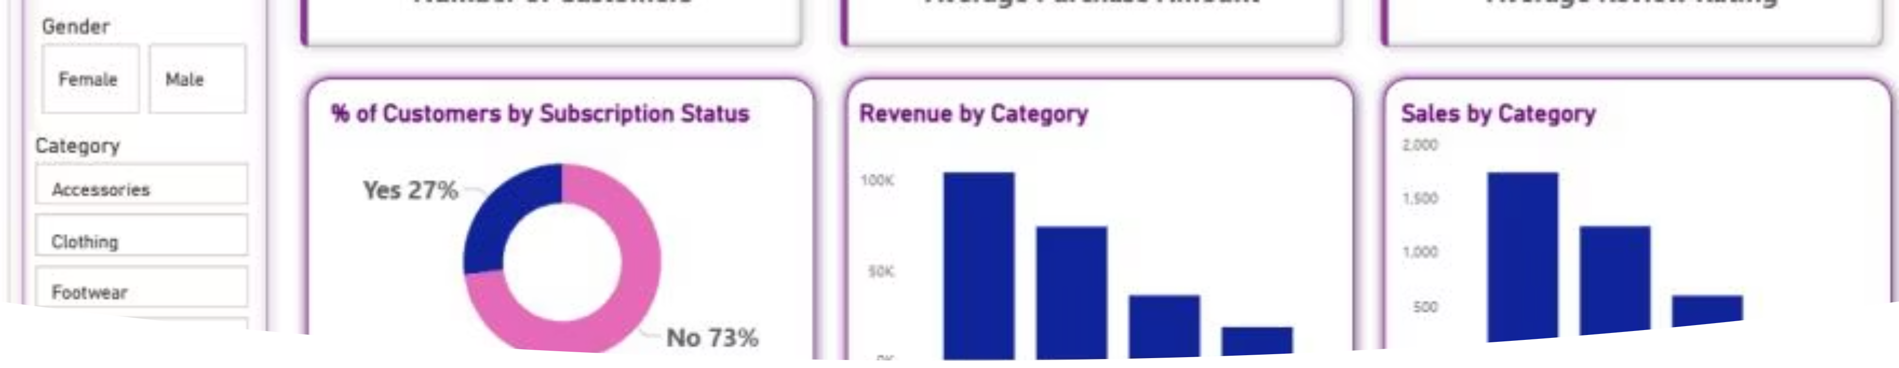
Interactive Dashboard Insights
Power BI dashboard visualizes key metrics including customer distribution, revenue by category and age group, and subscription status breakdown for real-time business intelligence.

Slide 10
Strategic Recommendations
01
02
03
Boost Subscription Adoption
Implement Loyalty Programs
Optimize Discount Policy
Promote exclusive benefits to convert the 2,518 repeat buyers who aren't yet subscribers—massive untapped potential.
Reward repeat buyers to accelerate their journey into the loyal customer segment through points and perks.
Balance promotional sales boosts with margin control, especially for discount-dependent product categories.
04
05
Highlight Top Performers
Target High-Value Segments
Feature top-rated products (Gloves, Sandals, Boots) and best-sellers in marketing campaigns to drive conversions.
Focus marketing efforts on Young Adults and express-shipping users who demonstrate higher revenue potential.

